Slide 1

Relational Harmony
Matthew 5:21-26
Dr. Rick Griffith
Crossroads International Church Singapore
www.BibleStudyDownloads.org

Slide 2

Relationships
Notes:
We often think that God cares more about our relationship with Him than how we relate to others. Is that true?

Slide 3

Which is more important to you—your vertical or horizontal relationships?
Notes:
Is your relationship with God or people more important in your life? In the next minutes, tell the person next to you your answer.
You might say that you will get better along with people when you first get along with God. That makes sense, doesn't it?
But others may say that it's hypocrisy to say that God is most important when your human relationships are rotten. This also sounds true to me!

Slide 4

The Wheel
THE OBEDIENT CHRISTIAN
P
R
A
Y
E
R
The Navigators
WITNESSING
FELLOWSHIP
THE
W
O
R
D
N
IN
I
O
A
T
C

Slide 5

We all want good relationships, right?

Slide 6

How can you sustain great relationships?

Slide 7

32 years marriage
25 years Singapore Bible College

Slide 8

Marriage
Notes:
The principles we'll see in God's Word today have sustained me through marriage, and I've been married longer than anyone here.

Slide 9


Let's get along with everyone that we can
Notes:
They also have helped me get along with thousands of people over the years.

Slide 10
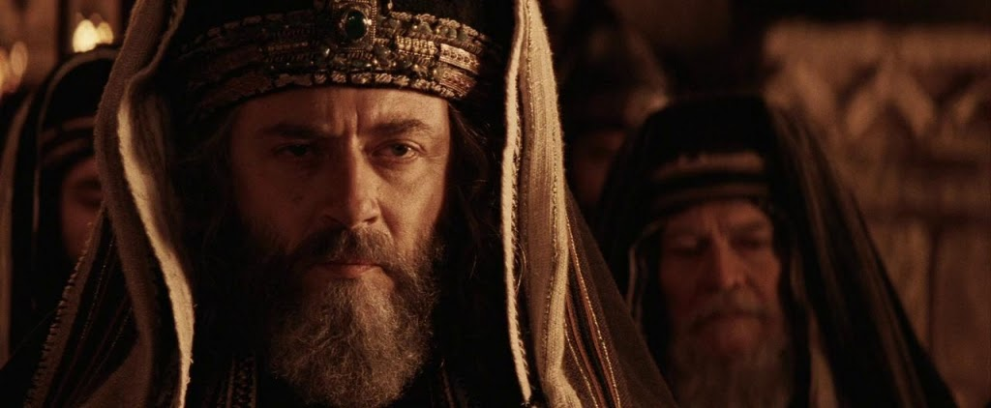
"The Epitome of Righteousness"
Notes:
The Pharisees of Jesus's time were thought righteous by the populace, yet they thought it good enough to care only for the vertical dimension with God in their lives.

Slide 11
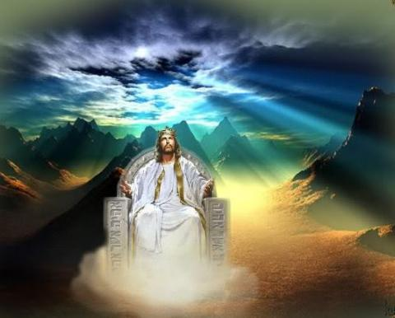
When Jesus is King…
(Matthew 5–7)
What would your life look like if Christ was truly the boss of your life?
Notes:
Today we address the fifth message in our series on the Sermon on the Mount, which I'm entitling "When Jesus is King."

Slide 12

How to be blessed (1-12)
How to
be a blessing (13-16)
Website
Notes:
Christ had shared how to be blessed (5:1-12), as well as the flip side of this: how to be a blessing to others.
• Some consider verses 13-16 a continuation of the Beatitudes since they still speak of the nature of those who know Christ—the attitudes and character they should show.

Slide 13

Read the OT but focus on Jesus
Main Idea of 5:17-20
Notes:
Jesus came to set a standard higher than the external law observances of the Pharisees.

Slide 14
The Wheel
THE OBEDIENT CHRISTIAN
P
R
A
Y
E
R
The Navigators
WITNESSING
FELLOWSHIP
THE
W
O
R
D
N
IN
I
O
A
T
C
Notes:
We tend to think that since our relationship with God is most important in life, that it's the only thing that's important!

Slide 15
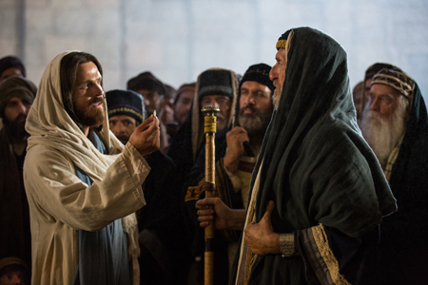
Jesus confronted the Pharisees
Notes:
Jesus corrects that misconception by sharing that relational harmony on the horizontal plane relates to our vertical fellowship with God

Slide 16

"Torah observant" but missing the point
Notes:
Of course, this put him in direct confrontation with the religious leaders of his day who were "Torah observant" but missed the point of the Law

Slide 17
Back to Basics (Matt. 5:21-48)
"You have heard that it was said…"
6 Issues:
"But I tell you…"
Murder
Adultery
Divorce
Vows
Revenge
Enemies
God's True Intent
Pharisee Teaching
External purity won't enter the kingdom (20)
Notes:
Here we see how "Jesus rejected the traditions of the Pharisees (vv. 21-48) … Six times Jesus said, "You have heard that it was said. ... But I tell you" (5:21-22, 27-28, 31-32, 33-34, 38-39, 43-44). These words make it clear that Jesus was presenting (a) what the Pharisees and teachers of the Law were saying to the people and, by contrast, (b) what God's true intent of the Law was. This spelled out His statement (v. 20) that Pharisaic righteousness is not enough to gain entrance into the coming kingdom" (Barbieri, BKC, 2:30).

Slide 18
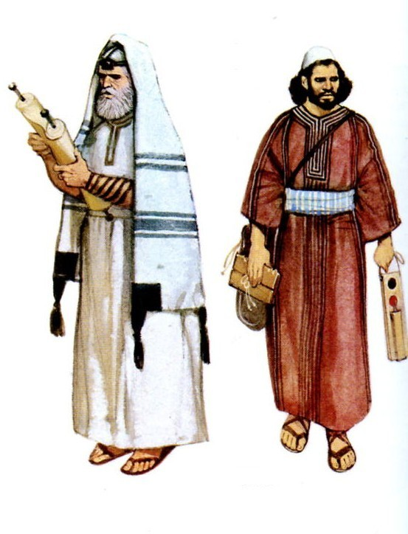
"For I tell you that unless your righteousness surpasses that of the Pharisees and the teachers of the law, you will certainly not enter the kingdom of heaven"
(5:20 NIV).
Notes:
This spelled out His statement (v. 20) that Pharisaic righteousness is not enough to gain entrance into the coming kingdom" (Barbieri, BKC, 2:30).

Slide 19

Sin comes from the attitudes of the heart
Notes:
"The Pharisees had a list of external actions that were sinful, but Jesus explained that sin came from the attitudes of the heart. Anger is murder in the heart; lust is adultery in the heart. The person who says that he 'lives by the Sermon on the Mount' may not realize that the Sermon on the Mount is more difficult to keep than the original Ten Commandments!" (Wiersbe, Matthew, Be Series, 50).

Slide 20

Pharisee Masks or Internal Holiness?
Notes:
The contrast in these six issues is NOT between the OT and the NT. Jesus is not saying that people should throw out the OT and embrace what he says. Instead, he is saying not to follow the Pharisee teaching or interpretation of the OT as it merely addresses external issues. The real intent of the Law is to change our hearts internally. The person who will enter the kingdom is not someone who follows all the OT rules; rather, the one entering the kingdom follows the Law's true meaning as this person knows the Lord.

Slide 21

"You have heard that it was said to the people long ago, 'Do not murder, and anyone who murders will be subject to judgment'" (5:21 NIV).

Slide 22
"But I tell you that anyone who is angry with his brother will be subject to judgment. Again, anyone who says to his brother, 'Raca,' is answerable to the Sanhedrin. But anyone who says, 'You fool!' will be in danger of the fire of hell" (5:22 NIV).

Slide 23
"Therefore, if you are offering your gift at the altar and there remember that your brother has something against you, ²⁴leave your gift there in front of the altar. First go and be reconciled to your brother; then come and offer your gift" (5:23-24 NIV).

Slide 24
"Settle matters quickly with your adversary who is taking you to court. Do it while you are still with him on the way, or he may hand you over to the judge, and the judge may hand you over to the officer, and you may be thrown into prison. ²⁶I tell you the truth, you will not get out until you have paid the last penny" (5:25-26 NIV).

Slide 25
How can you sustain great relationships?
3 ways

Slide 26
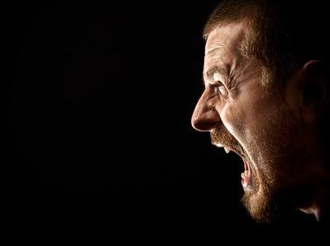
I. Watch your anger (21-22).
Notes:
The one hurt through anger that leads to murder is you

Slide 27
"You have heard that it was said to the people long ago, 'Do not murder, and anyone who murders will be subject to judgment'" (5:21 NIV).
Notes:
"Do not murder" was the sixth of the Ten Commandments.
Where did people hear this statement about murder (21)?
We don't have the actual original text quoted here, but Jesus noted that this was a longstanding tradition.
This likely was one of the traditions of the Pharisees. The effect is that it actually makes nearly all of us look pretty good—as long as you haven't murdered anyone.
In other words, the bar is set quite low—so low that we can all feel confident that we have met God's standard.

Slide 28
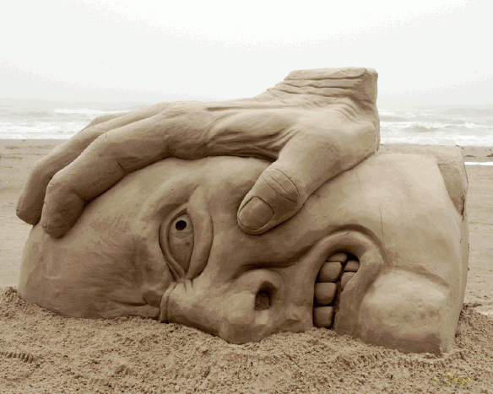
Anger
Notes:
But Jesus raised the bar by getting to the spirit of the command—anger! Now we're talking about something that relates to all of us—unless you one of those one-in-a-million folks who never struggles with anger or you have complete control of your tongue so you never utter anything that might make another person look foolish.

Slide 29
"But I tell you that anyone who is angry with his brother will be subject to judgment. Again, anyone who says to his brother, 'Raca,' is answerable to the Sanhedrin. But anyone who says, 'You fool!' will be in danger of the fire of hell" (5:22 NIV).

Slide 30

"But I tell you that anyone who is angry with his brother will be subject to judgment"
(5:22a NIV)
Notes:
God will judge you for anger (22a)

Slide 31

Is anger just as bad as murder?
Notes:
"The Pharisees taught that murder consists of taking someone's life. But the Lord said the commandment extended not only to the act itself but also to the internal attitude behind the act. Of course, murder is wrong, but the anger prompting the act is also as wrong as plunging in a knife" (Barbieri, "Matthew," BKC, 2:30).
Really? Did Jesus say that anger is just as bad as murder? No, he didn't say that. He only said that both would be judged! Murder is worse than anger—but its source is in anger.
Wiersbe writes, "Jesus did not say that anger leads to murder; He said that anger is murder" (emphasis his).
Anger Sinful?
Really? No, he didn't say that. He only said that both would be judged! Murder is worse than anger—but its source is in anger (supported by Blomberg, 106).

Slide 32

Is all anger sinful?
Righteous Anger:
Sinful Anger:
God's rights violated
Personal rights violated

Slide 33

How are you doing with your anger?

Slide 34

Anger Outlets
Notes:
Anger can get the best of us

Slide 35

You suffer most from your anger.
Notes:
You suffer most from your anger

Slide 36

Don't say "Raca" ("empty headed")
Notes:
The Greek word raca is not translated in some versions (NIV, WEB, KJV, ASV).
The literal meaning is "empty," probably referring to someone being "empty-headed." It is derived from a root meaning "to spit" (Easton), so it was an expression of contempt.
This is translated "idiot" (NLT), "good-for-nothing" (NAU), or "fool" (NET). Maybe "you stupid jerk" or "you numbskull" gets the idea!

Slide 37
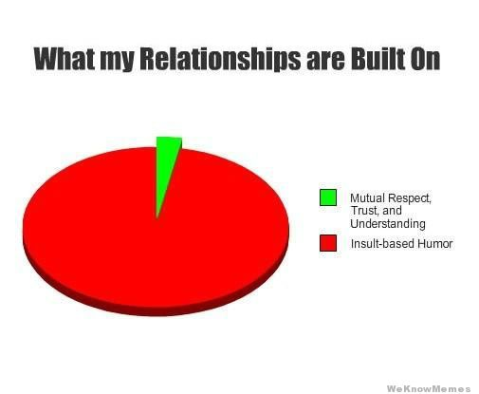
What One Person's Relationships are Built On
Mutual Respect, Trust, & Understanding
Insult-Based Humor

Slide 38

Good friends watch their words

Slide 39

"You fool!"
Notes:
If you curse someone, will this cause you to lose your salvation (22c)?
Some read this as a sign that the person isn't a believer anyway: "A person with such a sinful heart obviously is a sinner and therefore is headed for the fire of hell" (Barbieri, BKC).
Salvation is not through what you say or so not say to others.
The point is made clear in the NAS: "You shall be guilty enough to go into the fiery hell." Actually, any sin makes a person worthy of hell!
Cursing?
The point here is if you curse others, you deserve hell. Whether you go there or not depends on whether you have been saved from hell through Christ.

Slide 40

Are you quietly cursing anyone—even in your heart?

Slide 41
How can you sustain great relationships?

Slide 42
I. Watch your anger (21-22).

Slide 43

II. Watch your worship (23-24).
Notes:
The one hurt for not restoring a relationship before worshipping God is you

Slide 44
"Therefore, if you are offering your gift at the altar and there remember that your brother has something against you, ²⁴leave your gift there in front of the altar. First go and be reconciled to your brother; then come and offer your gift" (5:23-24 NIV).

Slide 45
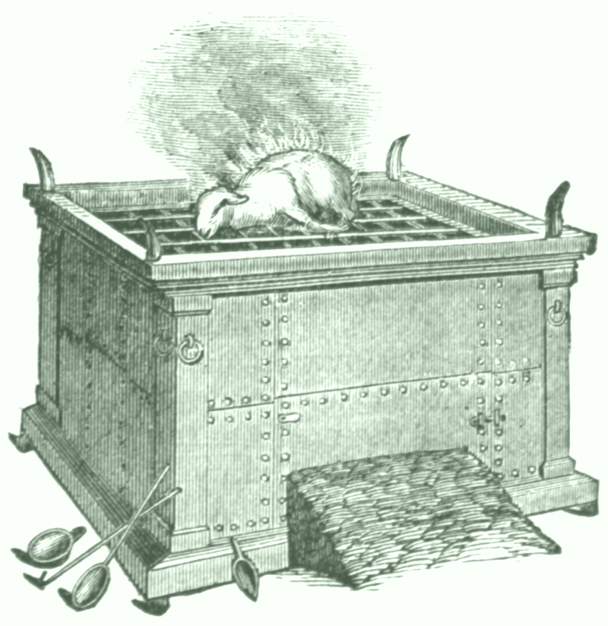

Matthew 5:23-24
Notes:
Take care of the horizontal before the vertical

Slide 46
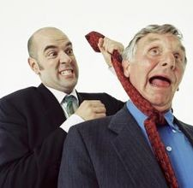
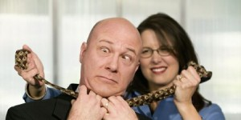
Too often we want revenge, not restoration
Notes:
Our first reaction when others hurt us is to want to hurt them back

Slide 47

"First go and be reconciled to your brother [sister]"
Notes:
Restoration must happen thousands of times in marriage—we need to assure that our relationship is in good order before approaching God

Slide 48
Matthew 5:23-24
?
"Therefore if you are presenting your offering at the altar, and there remember that your brother has something against you, leave your offering there before the altar and go; first be reconciled to your brother, and then come and present your offering."
Notes:
What would be the modern parallel to offering at the altar (23)?

Slide 49
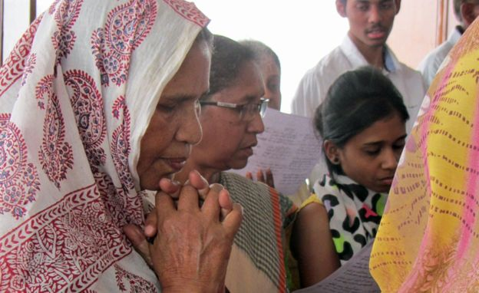
Our altar is approaching God in worship—corporately or privately
Notes:
Anytime we are approaching God in worship—corporately or privately—is a great time to evaluate your relationship with others

Slide 50
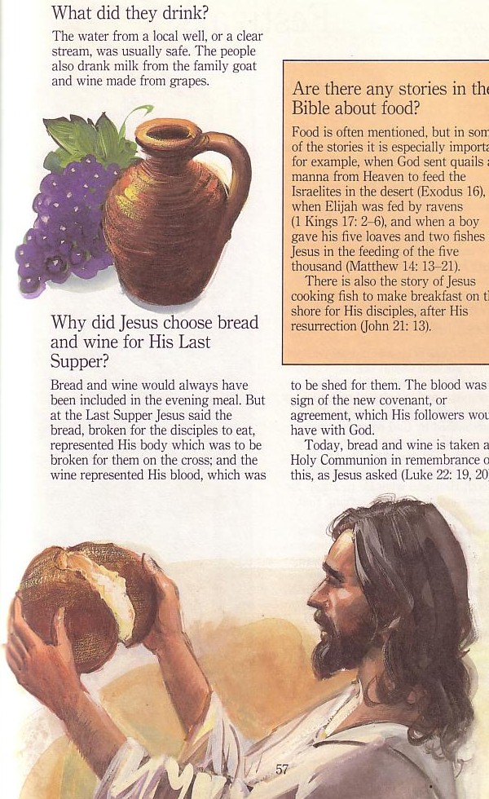
The Lord's Supper
Notes:
We need to take the Lord's Supper seriously.
I noticed that some of us let the elements pass last time. I see this positively rather than negatively. It says that you were evaluating your walk with God and others and felt that you still had some business to do. I only pray that you did do that business with God and/or others

Slide 51
The Four Directions
(Adapted from David Watson, I Believe in the Holy Spirit)
Look | Passover (Jewish) | Lord's Supper (Christian)
Outward | Whole family involved (Exod. 12:3-4, 16) | Fellowship and unity (1 Cor. 11:17-22; 10:16-17)
Back | Deliverance from Egypt (Exod. 12:31-42) | Deliverance from sin (1 Cor. 11:23-25)
Forward | Wait for messianic age (Ezek. 45:21) | Anticipate return of Christ (1 Cor. 11:26; Mark 14:25)
Inward | Purify house of leaven or evil (Exod. 12:8, 15) | Examine sin in yourself (1 Cor. 11:27-32; cf. 5:6-8)
Notes:
Like Passover, the Lord's Supper is a communal celebration

Slide 52

Reconciling with that person enables you to worship (24)
Notes:
Why is it so important to assure that our relationships with others are intact when worshipping God (23-24)?
One of the "problems" with God is that he is all knowing! He knows when we try to keep our lives in little "boxes" that supposedly do not overlap.
Sincerity in worship is not optional—it's required!

Slide 53

What if reconciliation attempts FAIL?
Notes:
God doesn't hold you responsible for the actions of others. A few times that I can remember in my life I asked others to forgive me for offending them and they said "no." One of those times was last November. God holds the other person with the unforgiving attitude responsible rather than you.

Slide 54

The Overall Principle
"If possible, as far as it depends on you, be at peace with all men"
Romans 12:18

Slide 55
How can you sustain great relationships?

Slide 56
I. Watch your anger (21-22).

Slide 57
II. Watch your worship (23-24).

Slide 58

II. Watch your money (25-26).
Notes:
The one hurt for not resolving a financial relationship is you

Slide 59
"Settle matters quickly with your adversary who is taking you to court. Do it while you are still with him on the way, or he may hand you over to the judge, and the judge may hand you over to the officer, and you may be thrown into prison. ²⁶I tell you the truth, you will not get out until you have paid the last penny" (5:25-26 NIV).
Notes:
Pay your debts quickly before you go to court (25a).
What kind of adversary who takes us to court is in verse 25?
The case here is when you have an honest debt to someone else. In such a case, it's wrong just to take your time to pay.
How do these verses about going to court relate to the context (25-26)?
The point they share in common is that hindered relationships have consequences—bad results, actually.
Jesus specifically gives two results of unresolved relations—loss of freedom and loss of money.

Slide 60

If you don't prioritize people, you can lose your freedom (25b).
Notes:
Wiersbe notes, "Anger is such a foolish thing. It makes us destroyers instead of builders. It robs us of freedom and makes us prisoners. To hate someone is to commit murder in our hearts (1 John 3:15)" (Wiersbe, 51).

Slide 61

Reconcile!
"Sinful anger must be faced honestly and must be confessed to God as sin. We must go to our brother and get the matter settled, and we must do it quickly. The longer we wait, the worse the bondage becomes! We put ourselves into a terrible prison when we refuse to be reconciled. (See Matt. 18:15–20 for additional counsel.) It has well been said that the person who refuses to forgive his brother destroys the very bridge over which he himself must walk"
—Warren Wiersbe, Matthew, 51

Slide 62

If you don't prioritize people, you can lose your money (26)
Notes:
One of my relatives is on his fifth marriage. He told me recently that his four divorces cost him so much money that he could have owned several houses instead!

Slide 63
How can you sustain great relationships?

Slide 64

Main Idea of 5:21-26
Make God and people your highest priorities.
Notes:
We'll have great relationships when we manage our anger, worship, and money

Slide 65
I. Watch your anger (21-22).

Slide 66
II. Watch your worship (23-24).

Slide 67
II. Watch your money (25-26).

Slide 68

How are your relationships?
How's your anger (21)?
How do you speak of others (22-23)?
How can you prioritize people in worship (24-25)?
How can you better manage your money (25-26)?
How is your relationship with Jesus?

Slide 69

The Best of All Relationships
Notes:
Jesus modeled the importance of relationships better than anyone ever!

Slide 70


NT Sermons link at BibleStudyDownloads.org
Get this presentation and script for free!

Slide 71
Black

